Slide 1
Machine Learning
Hy-Tech Camp

Slide 2
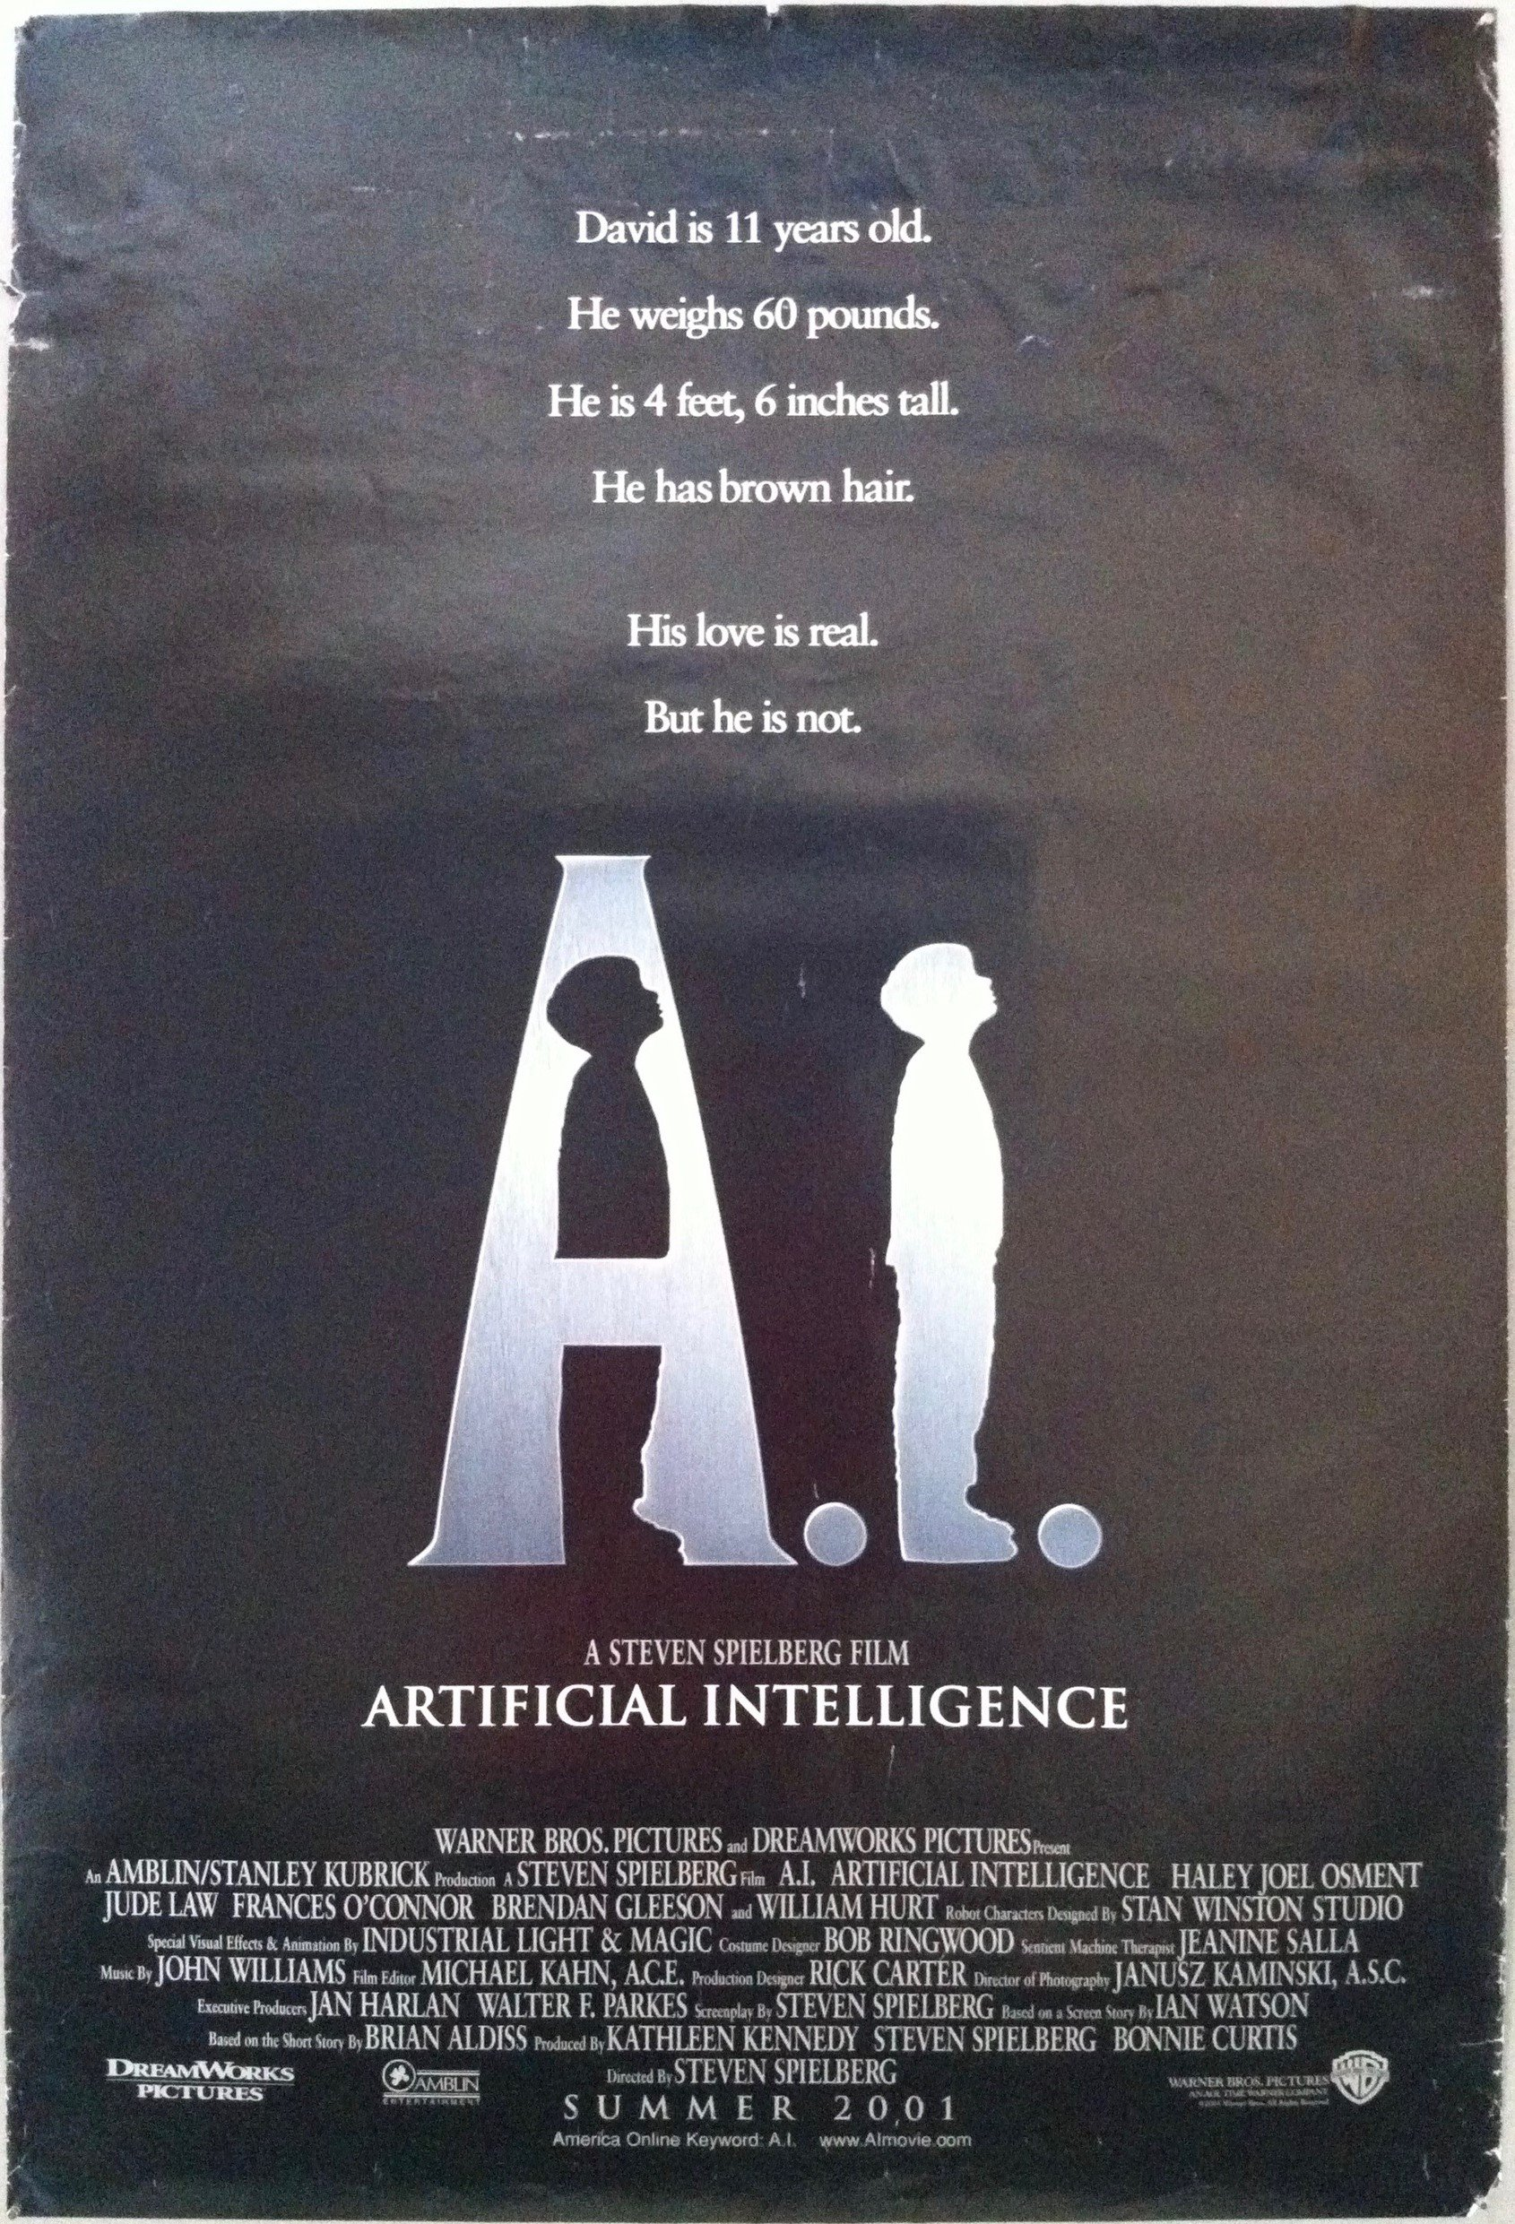
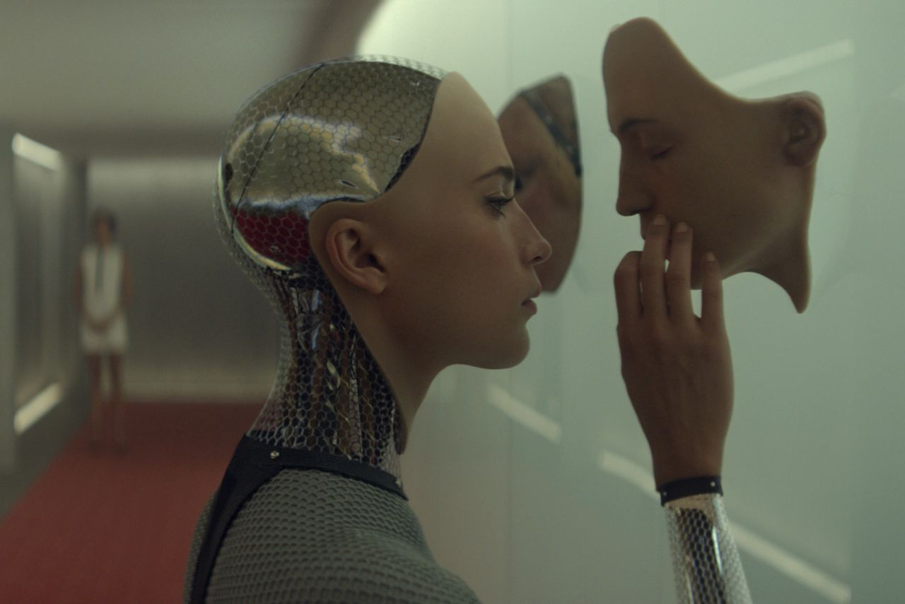
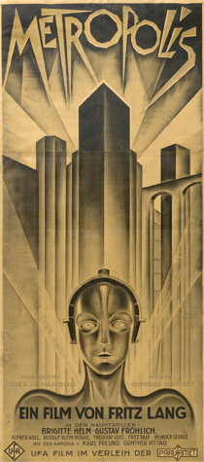
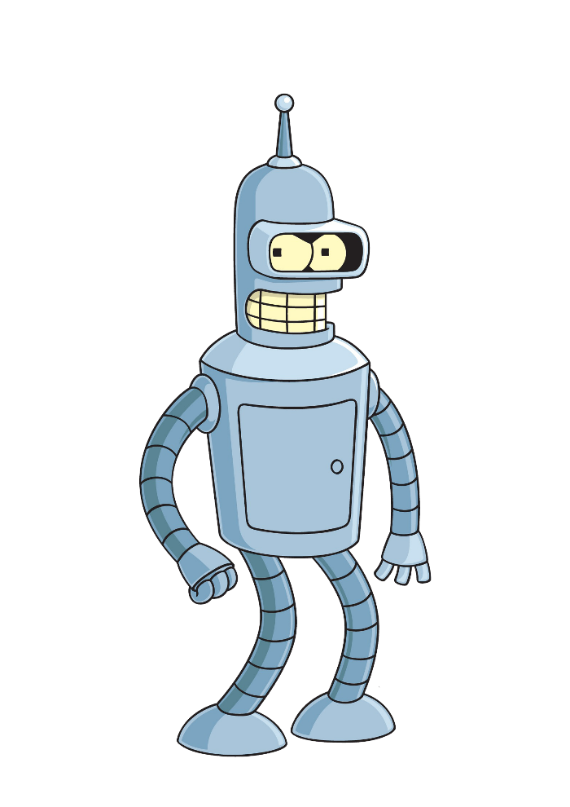
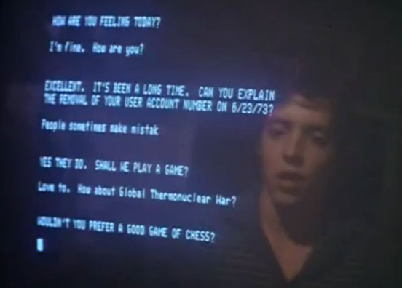
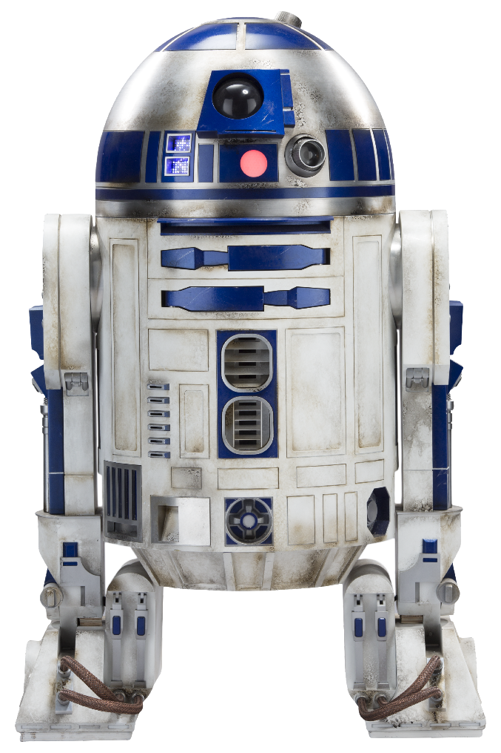
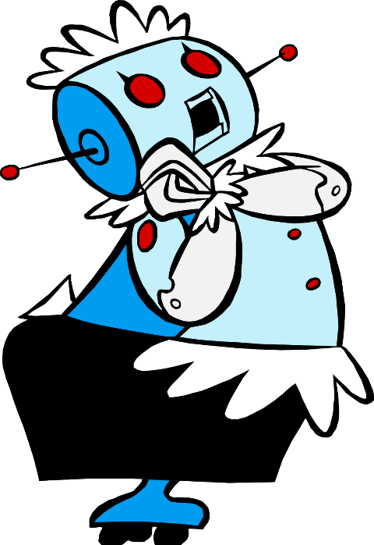
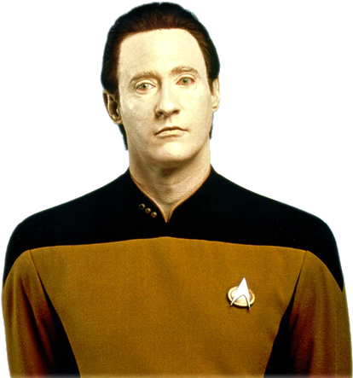
Notes:
Ask the students for examples of artificial intelligence they have seen in popular culture.
The examples in this slide, counter clockwise from top left:
A.I. Artificial Intelligence (2001)
Bender from Futurama
Ava from Ex Machina (2014)
Metropolis (1927)
Data from Star Trek: The Next Generation
Rosie from The Jetsons
R2D2 from Star Wars (1977)
WOPR from War Games (1983)
Ask the students if they recognize any of these.
The idea of artificial intelligence dates back to antiquity, where the concept was a storytelling device and a philosophical question. The list of modern depictions of AI goes on and on.
One of the most important and relevant examples is…

Slide 3
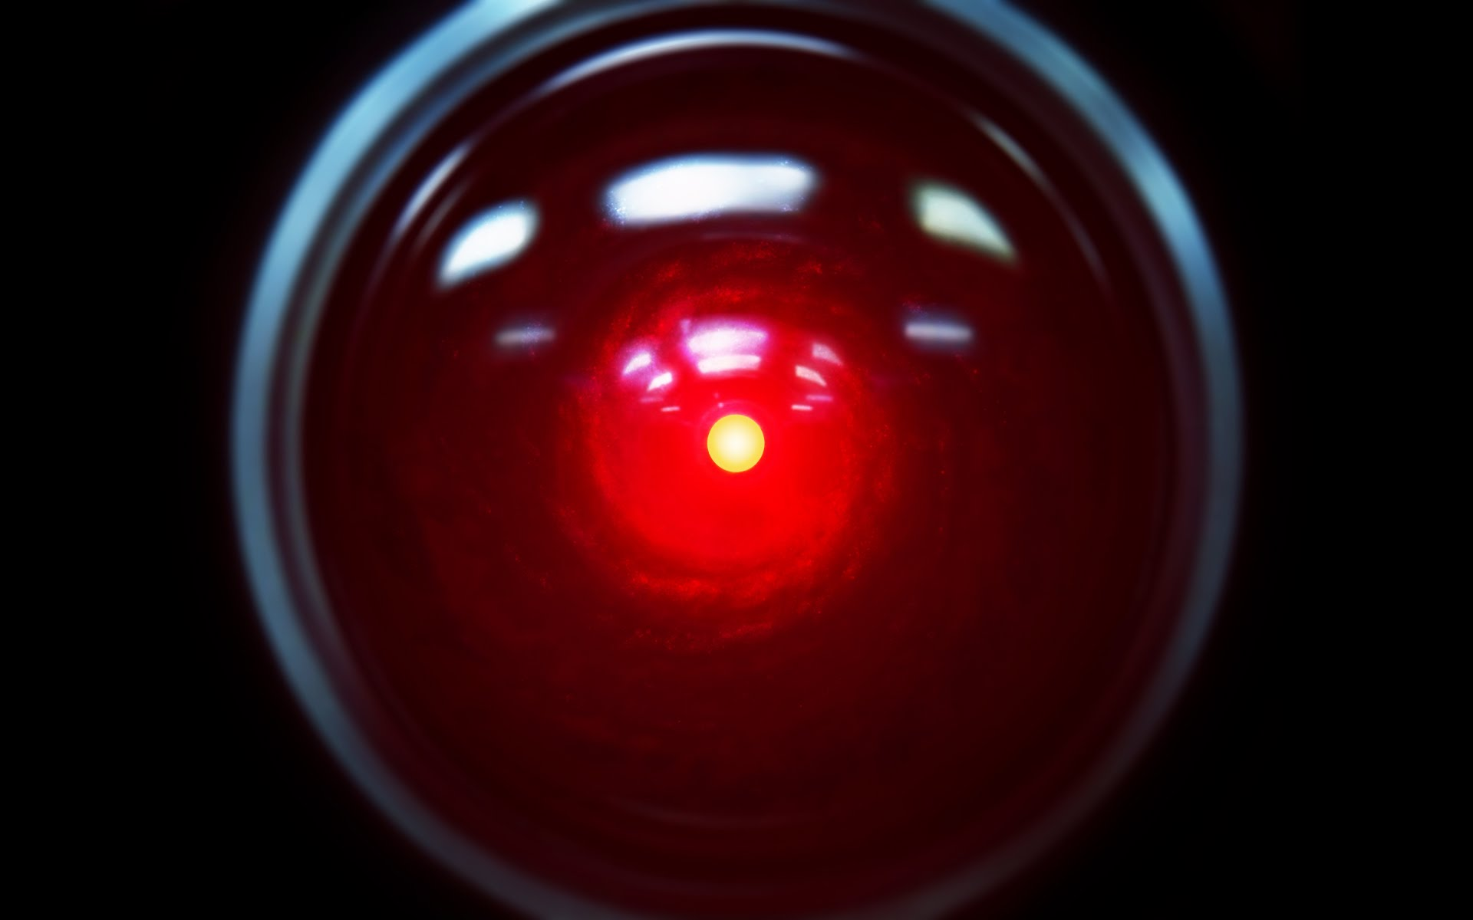
HAL 9000 from 2001: A Space Odyssey (1968)
Notes:
This one. Does anyone recognize this character? It is HAL 9000 from Stanley Kubrick’s classic 1968 film 2001: A Space Odyssey.
Back then, 2001 was the future, but now that year probably pre-dates the birth of most of the people here.
Now, almost twenty years beyond the setting of this film, we actually have something close to HAL…

Slide 4
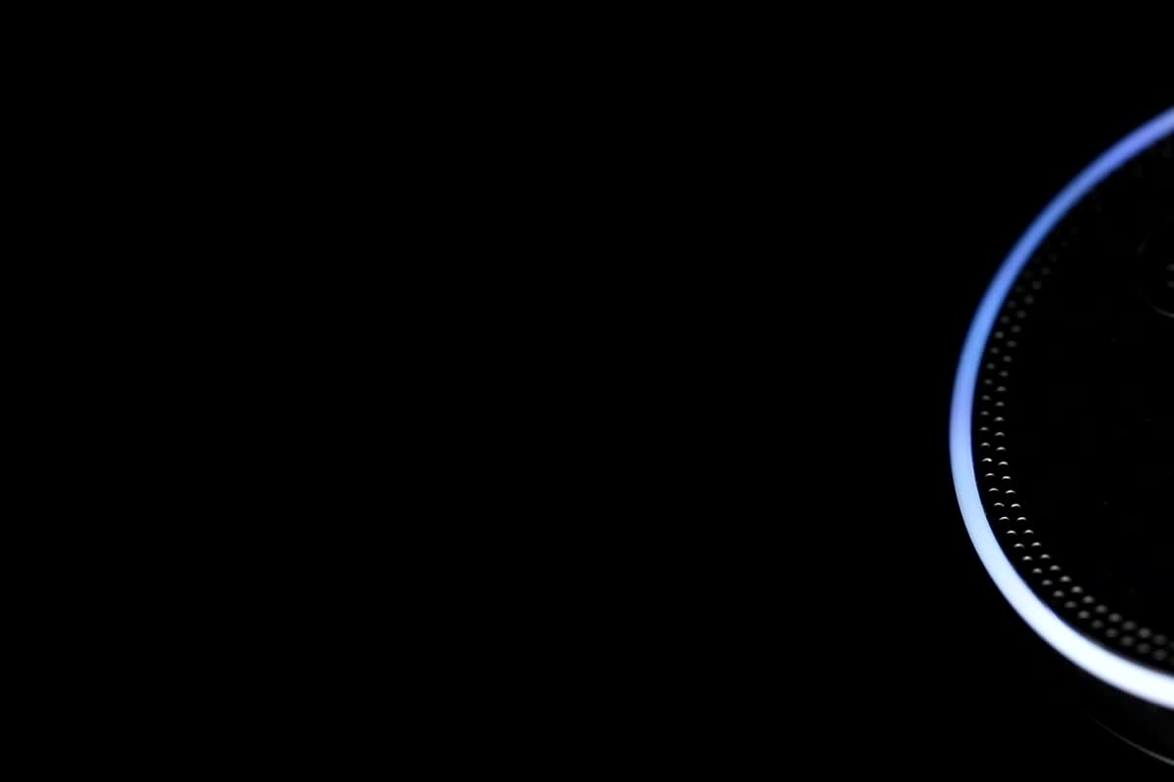
Smart Speakers
Autonomous Vehicles
Video Recommendations
Self-Regulating Thermostats
Artificial intelligence is science fiction!
Notes:
Smart Speakers (like Alexa, Siri, Google Home) are a real-world example of artificial intelligence. These are a lot like HAL… but they are real!
There are a lot of other modern applications for artificial intelligence too, like autonomous vehicles (e.g. self-driving cars), video recommendations (e.g. YouTube, Netflix), and self-regulating thermostats.
Ask the students if they know of any other real-world applications of artificial intelligence.
AI is no longer science fiction – it is now real science! But how did we get here?

Slide 5
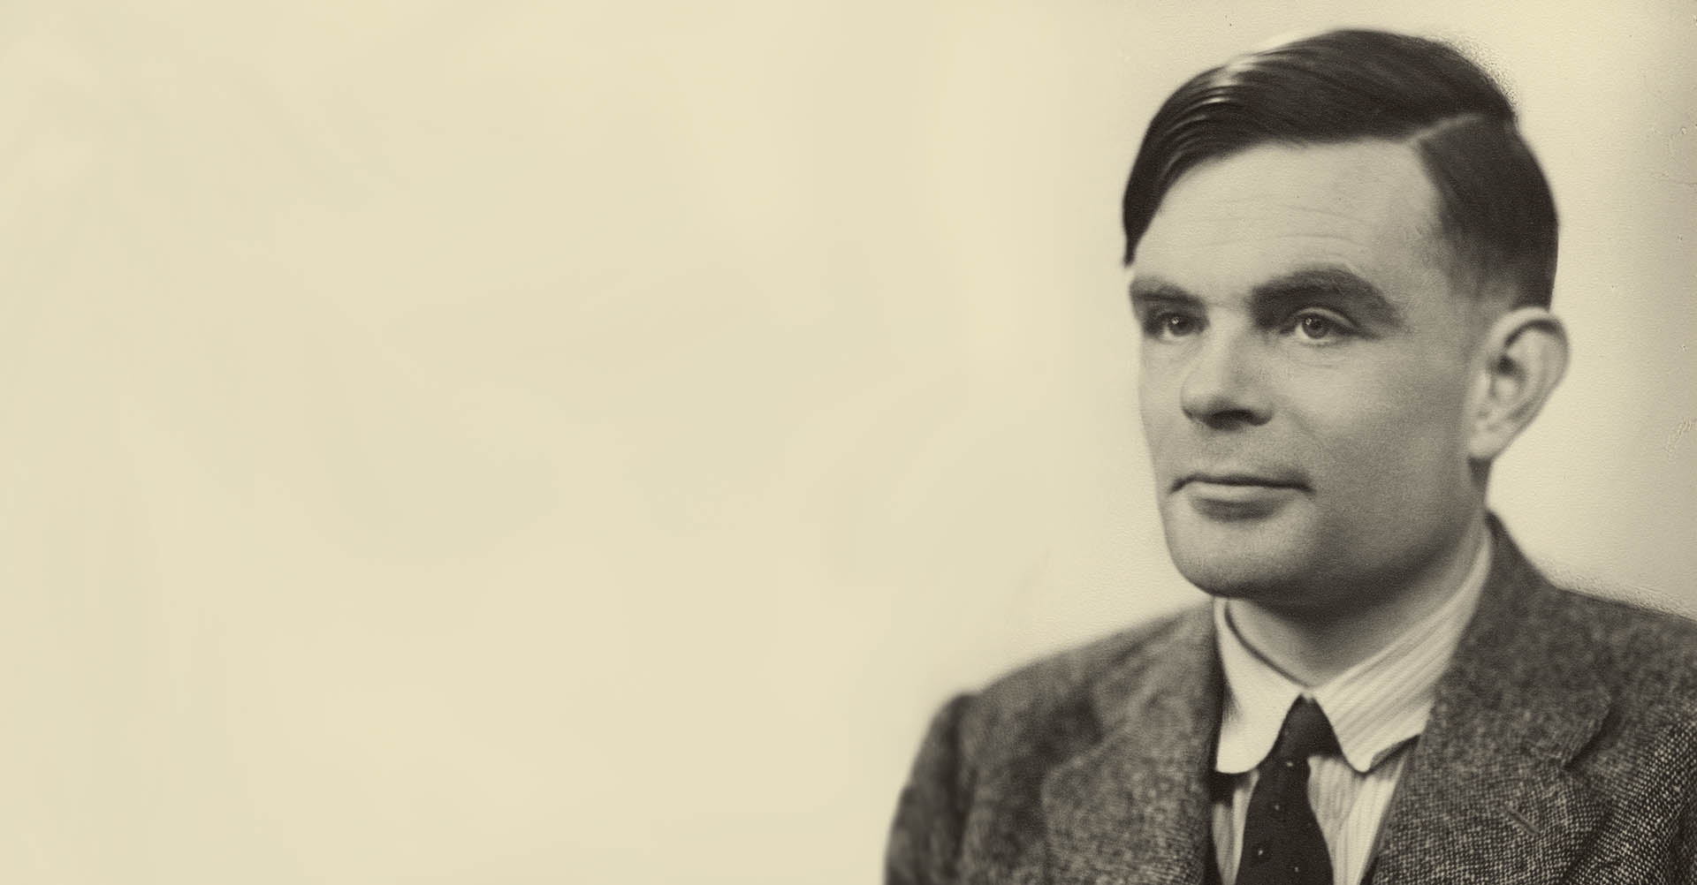
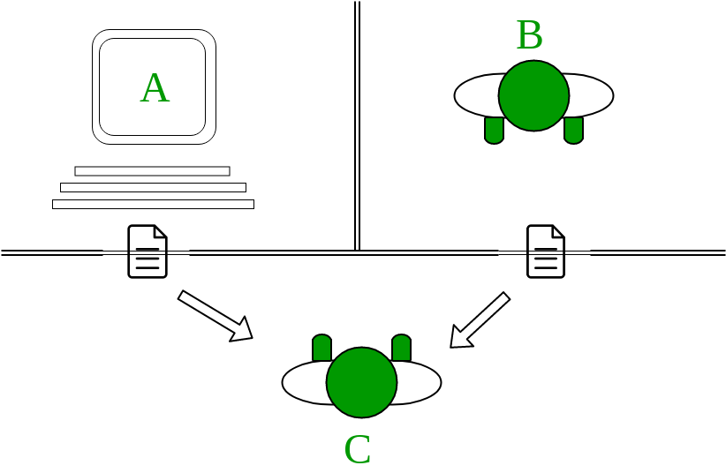
The Turing Test – 1950
Landmark paper in early AI
Conceived by Alan Turing – the father of artificial intelligence
Tests if a machine can “think”
Notes:
In 1950, Alan Turing invented the Turing Test, which was the first serious proposal in the philosophy of artificial intelligence. It essentially turned AI into science.
Alan Turing had numerous other accomplishments prior to the Turing Test. He was a WWII code-breaker, and created the Turing machine, a model of computation still used today. He liked to name things after himself.
The test was designed to analyze the ability of a machine to “think.”
How the test works
An interrogator (human) is given the task of determining which player (A or B) is a human. The interrogator can only use written questions and see written responses. If the interrogator is unable to divine which player is the computer, the computer “passes” the test.

Slide 6
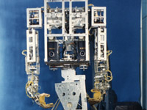
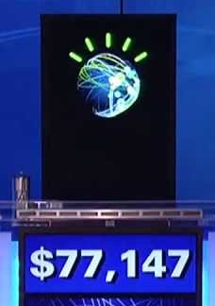


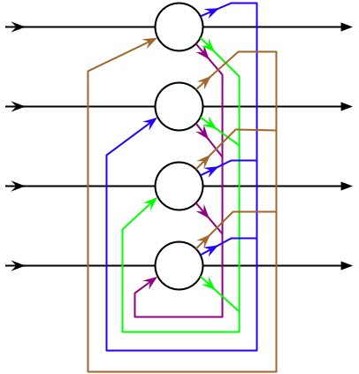
1950
Turing Test
1972
WABOT-1
1st Android
2011
Watson wins Jeopardy!
1987-1993
2nd AI Winter
1956
Dartmouth Conference
Birth of “Artificial Intelligence”
1980
XCON
Expert system
1964
ELIZA
Chatbot
1974-1979
1st AI Winter
1997
Deep Blue defeats Kasparov
1951
Game AI
1968
SHRDLU
Understanding natural language in blocks world
1982
Connectionism Revival
Present
Deep Learning,
Big Data, AGI
Notes:
1950 – Alan Turing created the Turing Test
1951 – Developers worked on machines that could play Chess and Checkers
1956 – The Dartmouth Conference coined the term “Artificial Intelligence”
1964 – ELIZA (one of the first chat bots) is created
1968 – SHRDLU is created. It allowed users to speak with a program to move blocks in a virtual world (called “blocks world”).
1972 – WABOT-1 (the first full-scale humanoid robot) is created.
1974-1979 – The first AI winter, funding went away because the promises of AI did not seem achievable
1980 – XCON (an expert system) saves the Digital Equipment Corporation several millions of dollars. Expert systems made AI useful.
1982 – Connectionism used artificial neural networks, which would eventually drive programs like optical character recognition and speech recognition
1987-1993 – A second AI winter caused by an economic bubble bursting
1997 – Deep Blue (a chess playing computer) defeats Garry Kasparov, the reigning world champion. This was a testament to the speed of modern computers
Between 1997 and 2011, AI is used behind-the-scenes for all sorts of applications like data mining, medical diagnosis, and Google’s search engine
2011 – IBM’s Watson wins Jeopardy. Computers keep getting faster
In the present, AI is used for deep learning, big data, and something called “artificial general intelligence” which tries to mimic human intelligence.
Al this history is interesting, but it’s a little dry. What does any of this actually mean?

Slide 7
Philosophical Questions Surrounding AI
Notes:
Many AI researchers do not care much about philosophy – they simply care if their AI works, if it achieves the goals it sets out to achieve. This is just a side-track because I think it’s interesting, it doesn’t really matter.
Ask the students the questions of the following slides. Poll them to see if they agree or disagree, then let a few students speak their thoughts if desired.

Slide 8
Philosophical questions surrounding AI
Can a machine actually understand anything?
Notes:
Elaborate on this question by discussing Searle’s Chinese Room Argument

Slide 9
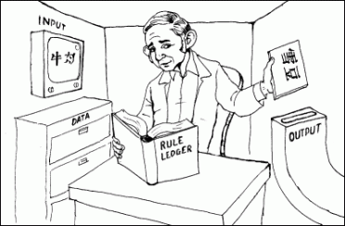
Searle’s Chinese Room Thought Experiment
A non-Chinese-speaking man is in a room with an input screen and an output box
The input contains Chinese characters
The man has a set of instructions to respond to each input with a proper output
The output makes those outside the room believe there is someone inside the room who speaks Chinese fluently
Does the man understand Chinese?
Notes:
Present Searle’s Chinese Room argument.
The logical conclusion is that this man cannot understand Chinese, he simply follows instructions without understanding. This is an attempt to show that computers, similarly, are incapable of understanding the symbols they manipulate, even though they can give the impression that they do.
Ask the students again what they think about a machine actually understanding anything. This may have changed some opinions, or not.

Slide 10
Philosophical questions surrounding AI
Is the human mind a physical thing?
Notes:
Does the mind exist in physical reality?

Slide 11
Philosophical questions surrounding AI
Will humans be made immortal by a technological singularity?
Notes:
Ask the students if they know what the technological singularity is. The technological singularity is the point at which machine intelligences supersedes human intelligence.

Slide 12
Philosophical questions surrounding AI
Could a superintelligent machine destroy all of humanity?
Notes:
When computers become more intelligent than humans, will they take over the world?

Slide 13
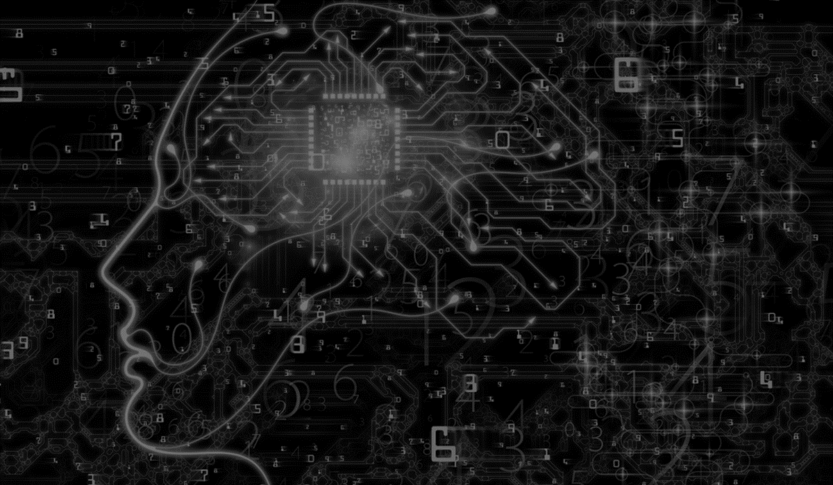
MACHINE LEARNING
Notes:
Let’s shift gears from the philosophical to the practical. Machine learning is a real thing that has a real impact on the world today!

Slide 14
What is machine learning?

Slide 15
Machine Learning Approaches
Supervised Learning
Unsupervised Learning
Reinforcement Learning

Slide 16
Machine Learning Models
Artificial Neural Networks
Decision Trees
Regression Analysis

Slide 17
Machine Learning Considerations
Overfitting
Confidence scores
Crowdsourcing
Training data variation

Slide 18
Applications
Sentiment Analysis
Image Recognition
Financial Market Analysis
Medical Diagnosis

Slide 19
Ethical considerations
Algorithmic Bias
Greed Bias

Slide 20
Machine Learning for kids
Notes:
Explain that Machine Learning For Kids is a browser-based tool that lets anyone create machine learning models and use them in code. It provides a user-friendly interface, so developers do not need to know what’s going on behind the scenes.
It shows how machine learning models are used to build applications.

Slide 21
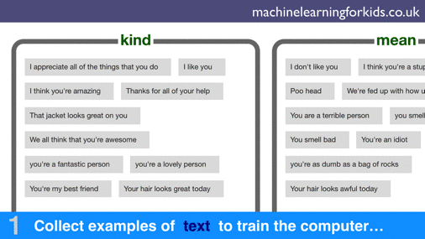
Notes:
Show this quick demonstration of the ML4K process.
Collect Examples
Train the Model
Create Applications with the Model

